Slide 1

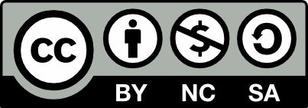



Testing Web Services
Unit Testing, Data Layer Testing, Web API Controllers Testing, Integration Testing
Web Services & Cloud
SoftUni Team
Technical Trainers
testing
Software University
http://softuni.bg

Slide 2

Table of Contents
Ways to Test a Web Service
Unit Testing vs. Integration Testing
Testing the Web Service Layers
Unit Testing the Data Layer
Unit Testing the Repositories Layer
Unit Testing the Services (Controllers)
Integration Testing of Web Services

Slide 3


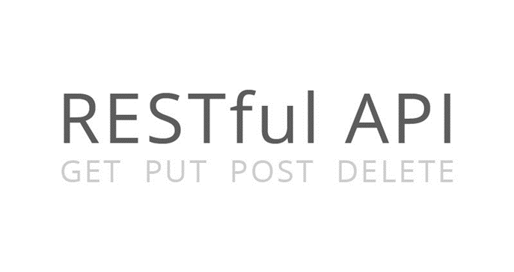
Web Service Testing
testing

Slide 4

Web Service Unit Testing
Web service unit testing is much like a regular unit testing
Writing test methods to test classes and their methods
A REST service is build from many more components
Data objects (POCO, data access logic)
HTTP status codes
HTTP response objects
Media types, JSON, XML
Access permissions, etc…
testing

Slide 5
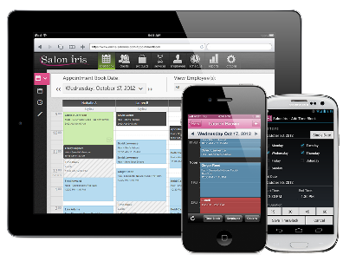


Web Service App: Typical Architecture
Web Service Client App
JS / C# / Java / Mobile App
Web Service Layer (REST Services)
Web API Controllers
Repository Layer (IRepository<T>)
C# Repositories
Data Access Layer (Models + ORM)
Entity Classes + EF
Database
MS SQL Server

Slide 6
Even More Layered Architecture
REST Services (Web Application)
Web API Controllers / REST Service Handlers
Service Layer (Business Logic)
C# / Java Service Classes
Repository Layer (IRepository<T>)
C# / Java Repositories
Data Model Classes (Entities)
POCO / POJO Classes (Entities)
ORM / Data Access Library
Entity Framework / Hibernate
Database / Data Store
SQL Server / MySQL / MongoDB

Slide 7
WS Unit Testing and Integration Testing
Levels of Web service testing:
Write unit tests to test the C# classes / logic
Test all objects, their constructors, properties and methods
Test the data access layer and repositories (CRUD operations)
Test the services / controllers (mock the database operations)
Write integration tests to test the components interaction
Test the entire application: from service endpoints to database
Use a real database, instead of mocking it

Slide 8
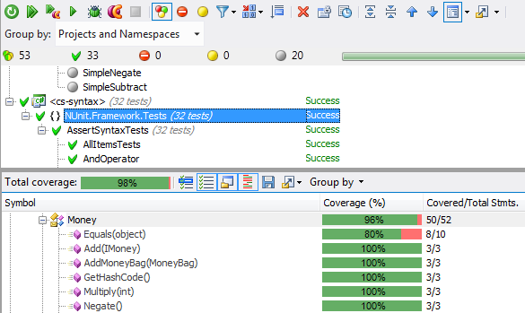

Unit Testing
Testing the Individual Components
testing

Slide 9
Unit Testing
The core idea of unit testing is to test the individual components of the application (units)
Test a single behavior (a method, property, constructor, etc.)
Unit tests should cover all components of the app
Data models and data access layer
Like data classes, repositories, DB access logic, XML read / write
Business layer
Services, controllers and their actions

Slide 10

Unit Testing the Data Layer
testing

Slide 11
Unit Testing the Data Layer
The data layer may not need testing
The idea of the data layer is to reference a data store (DB) with a ready-to-use framework
Entity Framework (EF) or other ORM
ORM frameworks are already tested enough
No point of testing dbContext.Set<T>.Add() and dbContext.Set<T>.SaveChanges(), right?
Still, we can test the data layer, by a traditional unit test
E.g. add some data to the DB and ensure it is stored correctly

Slide 12
Unit Testing the Data Layer – Example
[TestMethod]
public void AddBug_WhenBugIsValid_ShouldAddToDb()
{
// Arrange -> prepare the objects
var bug = new Bug() { … };
var dbContext = new BugTrackerDbContext();
// Act -> perform some logic
dbContext.Bugs.Add(bug);
dbContext.SaveChanges();
// Assert -> validate the results
var bugFromDb = dbContext.Bugs.Find(bug.Id);
Assert.IsNotNull(bugFromDb);
Assert.IsTrue(bugFromDb.Id != 0);
Assert.AreEqual(bug.Text, bugFromDb.Text);
…
}
testing

Slide 13
Unit Testing the Data Layer
testing
Live Demo

Slide 14


Unit Testing the Repositories
testing

Slide 15
Unit Testing the Repositories
It is essential to test the implementations of our repositories
The repositories hold the entire data store logic
CRUD operations, search operations, etc.
More complex data operations, e.g. complex search by many criteria
Repositories should correctly read / store data in the DB
Test whether the data is stored in the DB correctly
A missing dbContext.SaveChanges() can cause a lot of pain
Use a temporary (testing) DB or use transactions to avoid changes

Slide 16
How Should the Repositories be Tested?
What parts of the repositories should our tests cover?
Test for correct behavior
Add(), Delete(), Get(), All(), Find(), etc.
E.g. add an entity, load it from the DB and assert that it is correct
Or add a few entities, perform complex search and check the results
Test for incorrect behavior and expect exception
E.g. add an entity that has a NULL name
Test for duplicates on unique columns

Slide 17
Ways to Unit Test a Data Store (Repository)
How to test the data store logic?
Writing and deleting data in the production DB is not safe
Imagine a failed test that leaves 100k test records in the database
A few ways exist to unit test a data store
Manually create a copy of the data store and work on the copy
Backup the original data store, work on the original, and restore the backup when the tests execution completes
Use transactions, to prevent changes in the data store

Slide 18

Unit Testing with Transactions
When testing with transactions, the changes done are not really applied to the data store
Whatever committed, if tran.Complete() is not called, the transaction logic is rolled back
How to use transactions in unit tests?
Create a static TransactionScope instance
Initialize the transaction in TestInitialize()
Dispose the transaction in TestCleanup()
testing

Slide 19
Unit Testing with Transactions – Example
[TestMethod]
public void AddBug_WhenBugIsValid_ShouldAddToDb()
{
using (var tran = new TransactionScope())
{
// Arrange -> prepare the objects
var bug = new Bug() { … };
var repo = new BugsRepository(new BugTrackerDbContext());
// Act -> perform some logic
repo.Add(bug);
repo.SaveChanges();
// Assert -> validate the results
var bugFromDb = repo.Find(bug.Id);
Assert.IsNotNull(bugFromDb);
…
}
}
testing

Slide 20
Unit Testing Repositories with Transactions
testing
Live Demo

Slide 21
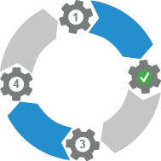

Unit Testing the Service Layer (Web API Controllers)
testing

Slide 22
Unit Testing the Service Layer
Testing the service layer actually means
Testing the Web API controllers and the REST API
Two main things to test:
Test if the controllers work correctly as C# classes
Using mocking or fake repositories to avoid database operations
Or use real database (no mocking) with temporary transactions
Test if the endpoints of the REST services return data correctly
Check the HTTP status code and the returned content (JSON / XML)

Slide 23
Unit Testing the Controllers
Unit testing of the controllers is like testing any other C# class
Instantiate a controller and test its methods (actions)
The repositories can be mocked / faked for easier testing
If not mocked, the transaction technique may be used again
Mocking simplifies unit testing by focusing on a single component
Still tests passed with mocking can fail when the DB is used
Mocking allows testing just the controller (a single unit)
Testing the controller + the DB is an integration test

Slide 24
Unit Testing Controllers with Fake Repositories
Repositories may be faked (mocked)
Use in-memory repository implementation of IRepository<T>
Or use a mocking framework like Moq, FakeItEasy, JustMock, …
Mocking the repositories
Separates the controller testing from the data store testing
Mocked tests run faster, but catch less bugs
Integration tests (without mocks)
More complex, run slower, but catch more problems

Slide 25

Fake Repository (Mock) – Example
public class RepositoryMock<T> : IRepository<T>
{
public IList<T> Entities { get; set; }
public RepositoryMock()
{
this.Entities = new List<T>();
}
public T Add(T entity)
{
this.Entities.Add(entity);
return entity;
}
…
}
testing

Slide 26
Testing with Fake Repository – Example
[TestMethod]
public void GetAll_WhenValid_ShouldReturnBugsCollection()
{
// Arrange
var bugs = new List<Bug>() { new Bug() { … }, … };
var repo = new RepositoryMock<Bug>();
repo.Entities = bugs;
var controller = new BugsController(repo);
// Act
var result = controller.GetAll();
// Assert
CollectionAssert.AreEquivalent(bugs, result.ToList<Bug>());
}
testing

Slide 27
Mocking a Repository with Moq – Example
[TestMethod]
public void GetAll_WhenValid_ShouldReturnBugsCollection_WithMocks()
{
// Arrange
var repoMock = new Mock<IRepository<Bug>>();
Bug[] bugs = { new Bug() { … }, new Bug() { … } };
repoMock.Setup(repo => repo.All()).Returns(bugs.AsQueryable());
var controller = new BugsController(repoMock.Object);
// Act
var result = controller.GetAll();
// Assert
CollectionAssert.AreEquivalent(bugs, result.ToArray<Bug>());
}

Slide 28
Controllers Unit Testing: GET vs. POST
GET actions are easy to test
They return IQueryable<T> / IEnumerable<T>
How to test POST actions?
They return HttpResponseMessage / IHttpActionResult
POST actions may require additional configuration
They rely on the request object, routes, etc.
We can manually setup request / routes before testing a controller

Slide 29
Sample POST Controller
public IHttpActionResult PostBug(Bug bug)
{
if (string.IsNullOrEmpty(bug.Text))
{
return this.BadRequest("Text cannot be null");
}
bug.Status = BugStatus.New;
bug.DateCreated = DateTime.Now;
this.repo.Add(bug);
this.repo.SaveChanges();
return CreatedAtRoute("DefaultApi", new { id = bug.Id }, bug);
}
It depends on the request object and routes

Slide 30
Preparing a POST Controller for Testing
private void SetupController(ApiController controller, string controllerName)
{
// Setup the Request object of the controller
var request = new HttpRequestMessage() {
RequestUri = new Uri("http://sample-url.com")};
controller.Request = request;
// Setup the configuration of the controller
controller.Configuration = new HttpConfiguration();
controller.Configuration.Routes.MapHttpRoute(
name: "DefaultApi", routeTemplate: "api/{controller}/{id}",
defaults: new { id = RouteParameter.Optional });
// Apply the routes to the controller
controller.RequestContext.RouteData = new HttpRouteData(
route: new HttpRoute(),
values: new HttpRouteValueDictionary { { "controller", controllerName } });
}

Slide 31
Unit Testing with Fake / Mocked Repositories
testing
Live Demo

Slide 32

Mocking without Repository + UoW Patterns
Embracing DbContext

Slide 33
Mocking DbContext Directly
DbContext can be mocked without the need of Repository + UoW pattern
Easier to do with Moq than manually creating a fake DbContext
Main Moq methods:
Setup() – sets an implementation for the specified method
Return() – sets the return value of a mocked method
Callback() – schedules a callback to execute when a specific method is invoked

Slide 34
Mocking for Get Action
public class AdsController : ApiController
{
public AdsController(OnlineShopContext data)
{
this.Data = data;
}
public OnlineShopContext Data { get; set; }
public IHttpActionResult GetAllAds()
{
var data = this.Data.Ads
.OrderByDescending(ad => ad.Name)
.Select(ad => ad.Name)
.ToList();
return this.Ok(data);
}

Slide 35
Mocking for Get Action (2)
[TestMethod]
public void TestGetAllAds()
{
var data = new List<Ad>() { new Ad() { Name = "Audi A6 second-hand" }}
.AsQueryable();
var mockSet = new Mock<DbSet<Ad>>();
mockSet.As<IQueryable<Ad>>().Setup(m => m.Provider)
.Returns(data.Provider);
mockSet.As<IQueryable<Ad>>().Setup(m => m.Expression)
.Returns(data.Expression);
mockSet.As<IQueryable<Ad>>().Setup(m => m.ElementType)
. .Returns(data.ElementType);
mockSet.As<IQueryable<Ad>>().Setup(m => m.GetEnumerator())
.Returns(data.GetEnumerator());
var mockContext = new Mock<OnlineShopContext>();
mockContext.Setup(c => c.Ads).Returns(mockSet.Object);
(example continues)

Slide 36
Mocking for Get Action (3)
var adsController = new AdsController(mockContext.Object);
SetupController(adsController, "ads");
var response = adsController.GetAllAds()
.ExecuteAsync(CancellationToken.None).Result;
Assert.AreEqual(HttpStatusCode.OK, response.StatusCode);
var adNames = response.Content
.ReadAsAsync<IEnumerable<string>>().Result;
Assert.IsTrue(adNames.Count() == 1);
}

Slide 37
Mocking for Post Action
[TestMethod]
public void TestAddNewAd()
{
var ads = new List<Ad>();
var mockSet = new Mock<DbSet<Ad>>();
mockSet.Setup(s => s.Add(It.IsNotNull<Ad>()))
.Callback((Ad a) => ads.Add(a));
var mockContext = new Mock<OnlineShopContext>();
mockContext.Setup(c => c.Ads)
.Returns(mockSet.Object);
var adsController = new AdsController(mockContext.Object);
this.SetupController(adsController, "ads");
(example continues)
When Add() is called, the ad will be persisted to the ads list

Slide 38
Mocking for Post Action (2)
var newPost = new CreateAdBindingModel()
{
Name = "New ad",
Price = 555,
Description = "Nothing much to say"
};
var response = adsController.Post(newPost)
.ExecuteAsync(CancellationToken.None).Result;
mockContext.Verify(c => c.SaveChanges(), Times.Once);
Assert.AreEqual(HttpStatusCode.OK, response.StatusCode);
Assert.IsTrue(ads.Count == 1);
Assert.AreEqual("New ad", ads[0].Name);
Asserts that SaveChanges() was called only once

Slide 39

Mocking DbContext Directly
Live Demo

Slide 40

Integration Testing of Web API Projects
testing

Slide 41
Integration Testing
Integration testing tests the work of the whole application
Not just small components like unit testing
Test the entire application, all its components mixed together
Tests the interaction between the components
REST service → repository layer → data access layer → DB
Integration tests should work like an end-user
Tests the entire system behavior from the user perspective
E.g. POST a new bug + check the HTTP response is correct + check the bug is saved in the DB correctly

Slide 42
Integration Testing of Web API Projects
In WebAPI, integration tests should cover:
The endpoints of the RESTful services
Test if the endpoint reaches the correct action
Test the service behavior
Includes data access, repositories and controller actions
Test the data serialization / the returned HTTP result
Does it return with JSON / XML
Does it return correct HTTP status code?
testing

Slide 43
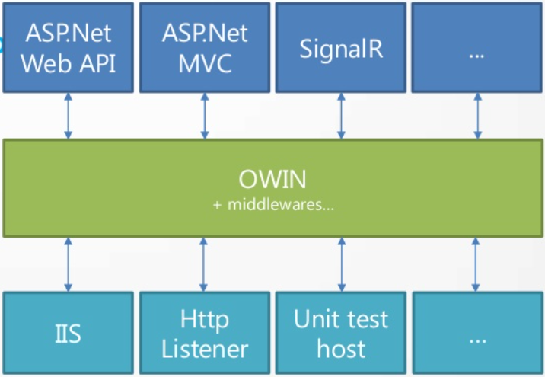
OWIN: Hosting ASP.NET Projects
OWIN — Open Web Interface for .NET

Slide 44
In-Memory Server: Microsoft.Owin.Testing
Microsoft has in-memory HTTP server for testing
Install Microsoft.OWIN.Testing from NuGet
It is just like a normal Web server but does not listen at certain port (e.g. http://localhost:9000)
It processes HTTP requests and produces HTTP responses
So you can test your Web API entirely
You can use the HttpClient to send HTTP requests
You have direct database access during the testing

Slide 45
Microsoft.Owin.Testing – Example
// Arrange: clean-up the database
var dbContext = new BugTrackerDbContext();
dbContext.Bugs.Delete(); dbContext.SaveChanges();
// Arrange: start OWIN testing HTTP server with Web API support
using (var httpTestServer = TestServer.Create(appBuilder => {
var config = new HttpConfiguration();
WebApiConfig.Register(config);
appBuilder.UseWebApi(config); })
{
var httpClient = httpTestServer.HttpClient)
// Act: perform an HTTP GET request
var httpResponse = httpClient.GetAsync("/api/bugs").Result;
var bugs = httpResponse.Content.ReadAsAsync<List<Bug>>().Result;
// Assert: check the returned results
Assert.AreEqual(HttpStatusCode.OK, httpResponse.StatusCode);
}

Slide 46
Integration Testing with OWIN
testing
Live Demo

Slide 47









Web Services Testing
https://softuni.bg/courses/web-services-and-cloud/

Slide 48
License
This course (slides, examples, demos, videos, homework, etc.) is licensed under the "Creative Commons Attribution-NonCommercial-ShareAlike 4.0 International" license
Attribution: this work may contain portions from
"Web Services and Cloud" course by Telerik Academy under CC-BY-NC-SA license

Slide 49






Free Trainings @ Software University
Software University Foundation – softuni.org
Software University – High-Quality Education, Profession and Job for Software Developers
softuni.bg
Software University @ Facebook
facebook.com/SoftwareUniversity
Software University @ YouTube
youtube.com/SoftwareUniversity
Software University Forums – forum.softuni.bg

